Slide 1
Futures Options and Black’s Model
Chapter 16

Slide 2
Options on Futures
Referred to by the maturity month of the underlying futures
The option is American and usually expires on or a few days before the earliest delivery date of the underlying futures contract

Slide 3
Mechanics of Call Futures Options
When a call futures option is exercised the holder acquires
A long position in the futures
A cash amount equal to the excess of the futures price at the most recent settlement over the strike price

Slide 4
Mechanics of Put Futures Option
When a put futures option is exercised the holder acquires
A short position in the futures
A cash amount equal to the excess of the strike price over the futures price at the most recent settlement

Slide 5
Example 16.1 (page 345)
July call option contract on gold futures has a strike of $1200 per ounce. It is exercised when futures price is $1,240 and most recent settlement is $1,238. One contract is on 100 ounces
Trader receives
  Long July futures contract on gold
  $3,800 in cash

Slide 6
Example 16.2 (page 346)
Sept put option contract on corn futures has a strike price of 300 cents per bushel.
It is exercised when the futures price is 280 cents per bushel and the most recent settlement price is 279 cents per bushel. One contract is on 5000 bushels
Trader receives
  Short Sept futures contract on corn
  $1,050 in cash

Slide 7
The Payoffs
If the futures position is closed out immediately:
Payoff from call = F – K
Payoff from put = K – F
where F is futures price at time of exercise

Slide 8
Potential Advantages of Futures
Options over Spot Options
Futures contract may be easier to trade than underlying asset
Exercise of the option does not lead to delivery of the underlying asset
Futures options and futures usually trade on the same exchange
Futures options may entail lower transactions costs

Slide 9
European Futures Options
European futures options and spot options are equivalent when futures contract matures at the same time as the option
It is common to regard European spot options as European futures options when they are valued in the over-the-counter markets

Slide 10
Put-Call Parity for European Futures Options (Equation 16.1, page 348)
Consider the following two portfolios:
1. European call plus Ke^{-rT} of cash
2. European put plus long futures plus cash equal to F₀e^{-rT}
They must be worth the same at time T so that
c + Ke^{-rT} = p + F₀ e^{-rT}

Slide 11
Other Relations
F₀ e^{-rT} – K < C – P < F₀ – Ke^{-rT}
c > (F₀ – K)e^{-rT}
p > (F₀ – K)e^{-rT}

Slide 12
Growth Rates For Futures Prices
A futures contract requires no initial investment
In a risk-neutral world the expected return should be zero
The expected growth rate of the futures price is therefore zero
The futures price can therefore be treated like a stock paying a dividend yield of r
This is consistent with the results we have presented so far (put-call parity, bounds, binomial trees)

Slide 13
Valuing European Futures Options
We can use the formula for an option on a stock paying a dividend yield
  S₀ = current futures price, F₀
  q = domestic risk-free rate, r
Setting q = r ensures that the expected growth of F in a risk-neutral world is zero
The result is referred to as Black’s model because it was first suggested in a paper by Fischer Black in 1976

Slide 14
How Black’s Model is Used in Practice
European futures options and spot options are equivalent when future contract matures at the same time as the otion.
This enables Black’s model to be used to value a European option on the spot price of an asset
One advantage of this approach is that income on the asset does not have to be estimated explicitly

Slide 15
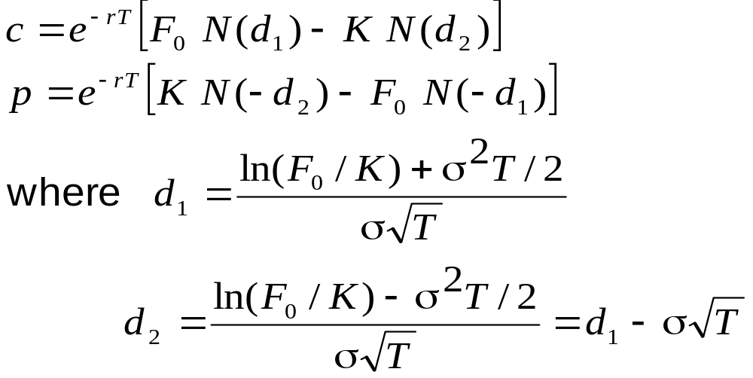
Black’s Model
(Equations 16.5 and 16.6, page 350)
The formulas for European options on futures are known as Black’s model

Slide 16
Using Black’s Model Instead of Black-Scholes (Example 16.5, page 351)
Consider a 6-month European call option on spot gold
6-month futures price is 1240, 6-month risk-free rate is 5%, strike price is 1200, and volatility of futures price is 20%
Value of option is given by Black’s model with F₀=12400, K=1200, r=0.05, T=0.5, and σ=0.2
It is 88.37

Slide 17
Binomial Tree Example
A 1-month call option on futures has a strike price of 29.
Futures Price = $33
Option Price = $4
Futures price = $30
Option Price=?
Futures Price = $28
Option Price = $0

Slide 18
Setting Up a Riskless Portfolio
Consider the Portfolio: long Δ futures short 1 call option
Portfolio is riskless when 3Δ – 4 = –2Δ or Δ = 0.8
3Δ – 4
-2Δ

Slide 19
Valuing the Portfolio
( Risk-Free Rate is 6% )
The riskless portfolio is:
long 0.8 futures short 1 call option
The value of the portfolio in 1 month is –1.6
The value of the portfolio today is –1.6e ^{– 0.06/12} = –1.592

Slide 20
Valuing the Option
The portfolio that is
long 0.8 futures short 1 option
is worth –1.592
The value of the futures is zero
The value of the option must therefore be 1.592

Slide 21
Generalization of Binomial Tree Example (Figure 16.2, page 353)
A derivative lasts for time T and is dependent on a futures price
F₀u
ƒ_{u}
F₀
ƒ
F₀d
ƒ_{d}

Slide 22
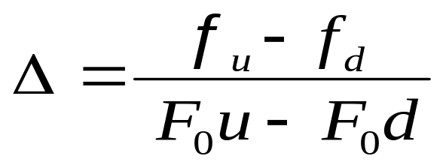
Generalization
(continued)
Consider the portfolio that is long Δ futures and short 1 derivative
The portfolio is riskless when
F₀u Δ − F₀ Δ – ƒ_{u}
F₀d Δ− F₀Δ – ƒ_{d}

Slide 23
Generalization
(continued)
Value of the portfolio at time T is F₀u Δ –F₀Δ – ƒ_{u}
Value of portfolio today is – ƒ
Hence ƒ = – [F₀u Δ –F₀Δ – ƒ_{u}]e^{-rT}

Slide 24
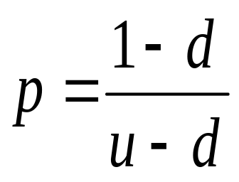
Generalization
(continued)
Substituting for Δ we obtain
ƒ = [ p ƒ_{u} + (1 – p )ƒ_{d} ]e^{–rT}
where

Slide 25
American Futures Option Prices vs American Spot Option Prices
If futures prices are higher than spot prices (normal market), an American call on futures is worth more than a similar American call on spot. An American put on futures is worth less than a similar American put on spot
When futures prices are lower than spot prices (inverted market) the reverse is true

Slide 26
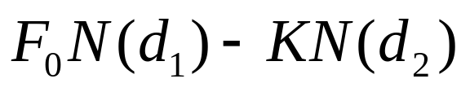
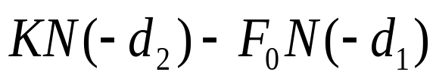
Futures Style Options (page 354-55)
A futures-style option is a futures contract on the option payoff
Some exchanges trade these in preference to regular futures options
The futures price for a call futures-style option is
The futures price for a put futures-style option is

Slide 27
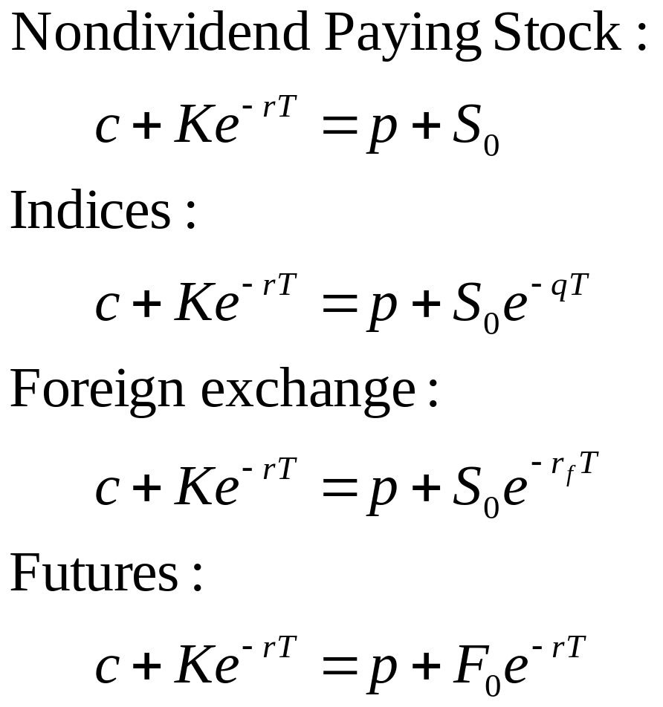
Put-Call Parity Results: Summary

Slide 28
Summary of Key Results from Chapters 15 and 16
We can treat stock indices, currencies, & futures like a stock paying a continuous dividend yield of q
  For stock indices, q = average dividend yield on the index over the option life
  For currencies, q = r_{ƒ}
  For futures, q = r

